Slide 1

YouTube Song Analysis - Power BI
Divyadharshini Arulkannan
Batch Name: MIP-DA-10

Slide 2
Contents :
Introduction
Executive Summary
Detailed Analysis
Recommendations
Conclusion

Slide 3
Introduction
Power BI is a powerful business analytics tool developed by Microsoft. It allows users to visualize and share insights from their data through interactive dashboards and reports. Whether you're analyzing sales data, tracking social media metrics, or evaluating trends in YouTube song performance, Power BI empowers you to transform raw data into actionable insights.
Why Use Power BI?
Empower Decision-Making: By transforming complex data into actionable insights, Power BI enables organizations to make data-driven decisions quickly and effectively.
Flexibility and Scalability: Whether you're a small business or a large enterprise, Power BI scales to meet your needs, offering flexibility in data visualization and analysis.
Integration with Microsoft Ecosystem: Seamless integration with other Microsoft products such as Excel, Azure, and Office 365 enhances productivity and data management capabilities.

Slide 4
Executive Summary
Key Findings:
Total Engagement Metrics:
Total views across analyzed videos reached 231 Bn. Likes received demonstrated strong engagement, with an total of 2 Bn likes.
Comments posted reflected active viewer interaction, totaling 51 Mn comments.

Slide 5
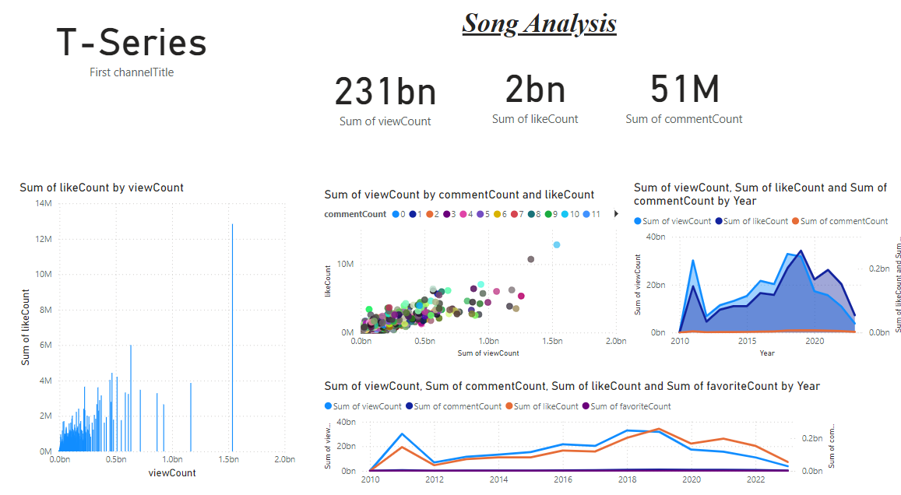

Slide 6
Popular Channels:
Channel – T- Series emerged as top performers in terms of viewer engagement and video popularity.
Impact of Tags:
Tags associated with genres like hindi_songs, bollywood_songs, and baby_trailer showed a significant correlation with higher view counts, indicating their importance in video discovery and audience reach.

Slide 7
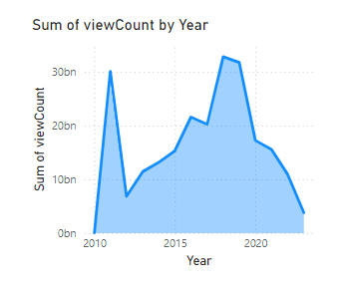
Peak Publishing Times:
Analysis revealed that publishing videos during 2012 and 2019 led to increased viewer engagement, suggesting optimal publishing strategies to maximize reach and impact.

Slide 8
Detailed Analysis
Channel Analysis:
Distribution and Performance:
Visualize the distribution of videos across channels.
Compare engagement metrics (views, likes, comments) for top-performing channels.
Recommendations:
Suggest collaborations with popular channels to leverage their audience.
Propose content strategies tailored to each channel's audience preferences.

Slide 9
Detailed Analysis
Tags Analysis:
Tag Frequency and Impact:
Analyze the frequency and effectiveness of tags in driving views.
Show correlations between specific tags and viewer engagement metrics.

Slide 10
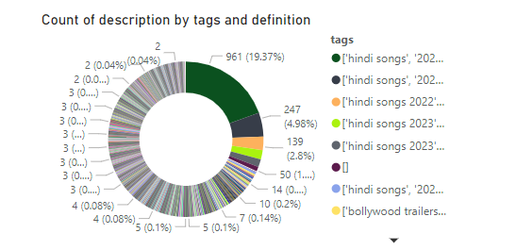
Detailed Analysis
Optimization Strategies:
Recommend using trending tags and optimizing tag combinations for increased video discoverability.

Slide 11
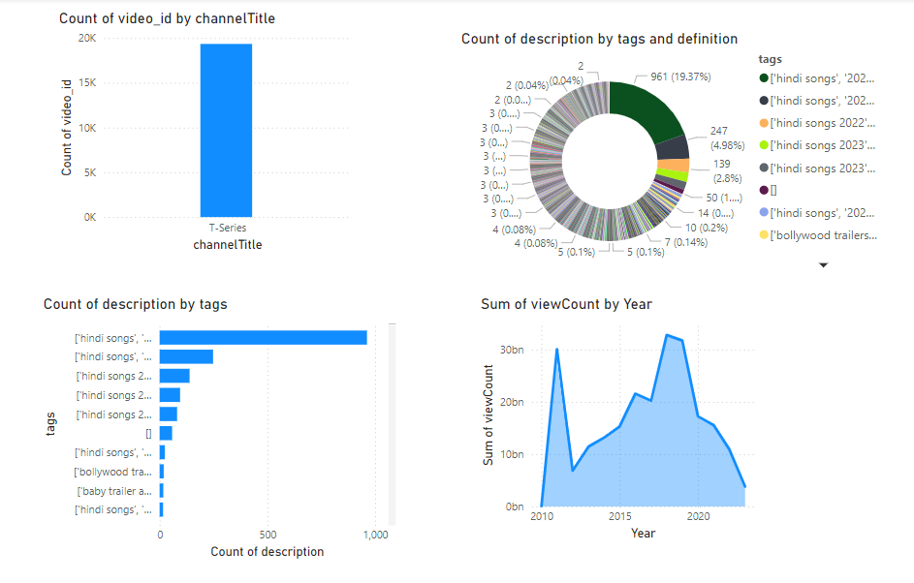

Slide 12
Temporal Trends:
Time-Based Analysis:
Plot trends in views, likes, and comments over different time intervals (daily, weekly, monthly).
Identify seasonal variations and their impact on video performance.
Strategic Insights:
Highlight the best times to publish videos based on peak engagement periods.
Provide strategies for scheduling content releases to align with viewer activity patterns.

Slide 13
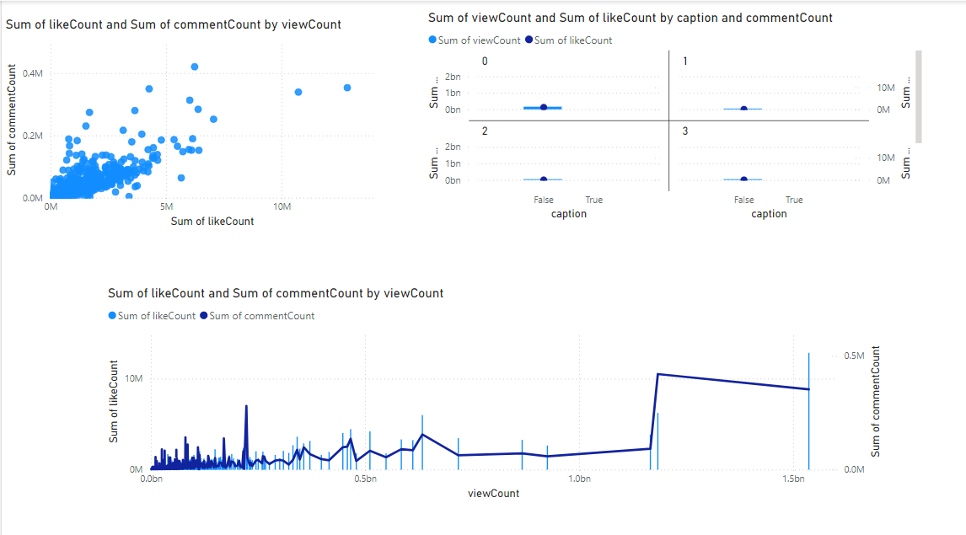

Slide 14
Engagement Insights:
Relationship Analysis:
Explore relationships between likes, comments, and views using scatter plots or correlation matrices.
Identify factors influencing viewer engagement and interaction with video content.
Enhancement Strategies:
Recommend tactics to increase viewer interaction, such as encouraging comments, enhancing video descriptions, or improving video quality.

Slide 15
Recommendations
Actionable Recommendations:
Content Strategy Optimization:
Focus on producing content that resonates with the preferences of top-performing channels’ audiences.
Incorporate trending tags identified in the analysis to enhance discoverability.
Engagement Enhancement:
Implement strategies to foster viewer engagement, such as interactive content formats or live streaming events.
Encourage audience interaction through compelling calls-to-action and responsive community management.

Slide 16
Recommendations
Maximizing Performance:
Utilize insights on peak publishing times to schedule content releases for maximum impact.
Continuously monitor and adapt content strategies based on real-time viewer feedback and performance metrics.

Slide 17
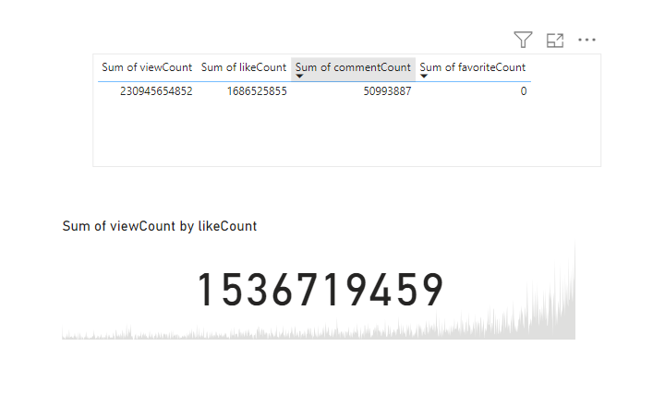

Slide 18
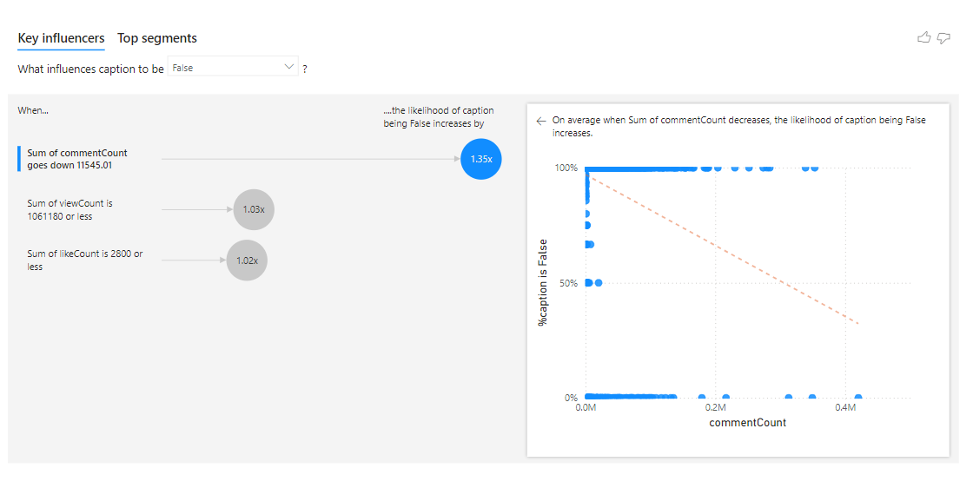

Slide 19
Conclusion :
The analysis using Power BI has provided valuable insights into the dynamics of YouTube song videos. By leveraging data-driven strategies, content creators can optimize their approach to content creation, enhance viewer engagement, and ultimately maximize the performance of their YouTube channels.

